Slide 1
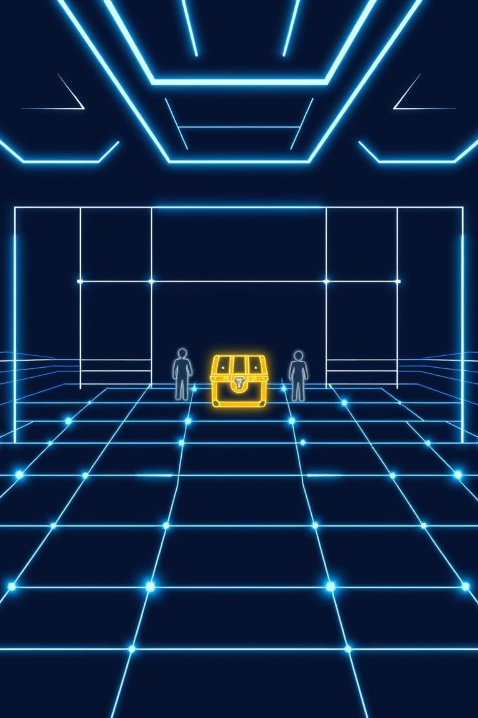
Treasure Hunt AI Project
I -guided by Manisha Divate

Slide 2
DEV-53003230073
KASAK-53003230071
HETVI-53003230067
SRUSHTI-53003230097

Slide 3
Problem Statement
Reach the treasure first, navigating obstacles and opponent moves.
Interactive Gameplay
AI-Assisted Movement
Dynamic Obstacles
Manual navigation and obstacle placement.
BFS pathfinding for shortest path.
Strategically block opponent's path.

Slide 4
Scope of the Game
Grid Environment
Manual Control
Fixed 10x10 grid.
Keyboard movement, obstacle placement.
Agents
AI-Assisted Movement
Two agents, opposite corners.
Single-step BFS pathfinding.
Treasure Placement
Win Conditions
Random, minimum Manhattan distance.
First to reach treasure wins.

Slide 5




Existing Approaches
Search Algorithms
Multi-Agent Systems
BFS for shortest path in unweighted grid.
Competitive AI on grids.
Obstacle Navigation
Interactive AI Games
Dynamic path recalculation.
Pygame for rendering and input.

Slide 6
Theoretical Concepts
Breadth-First Search (BFS)
Manhattan Distance
Explores layer by layer for shortest path.
Sum of absolute coordinate differences.
Queue of positions, predecessor map.
Ensures fair treasure placement.
Manual Controls
One cell at a time, cardinal directions.
Obstacles on empty adjacent cells.

Slide 7
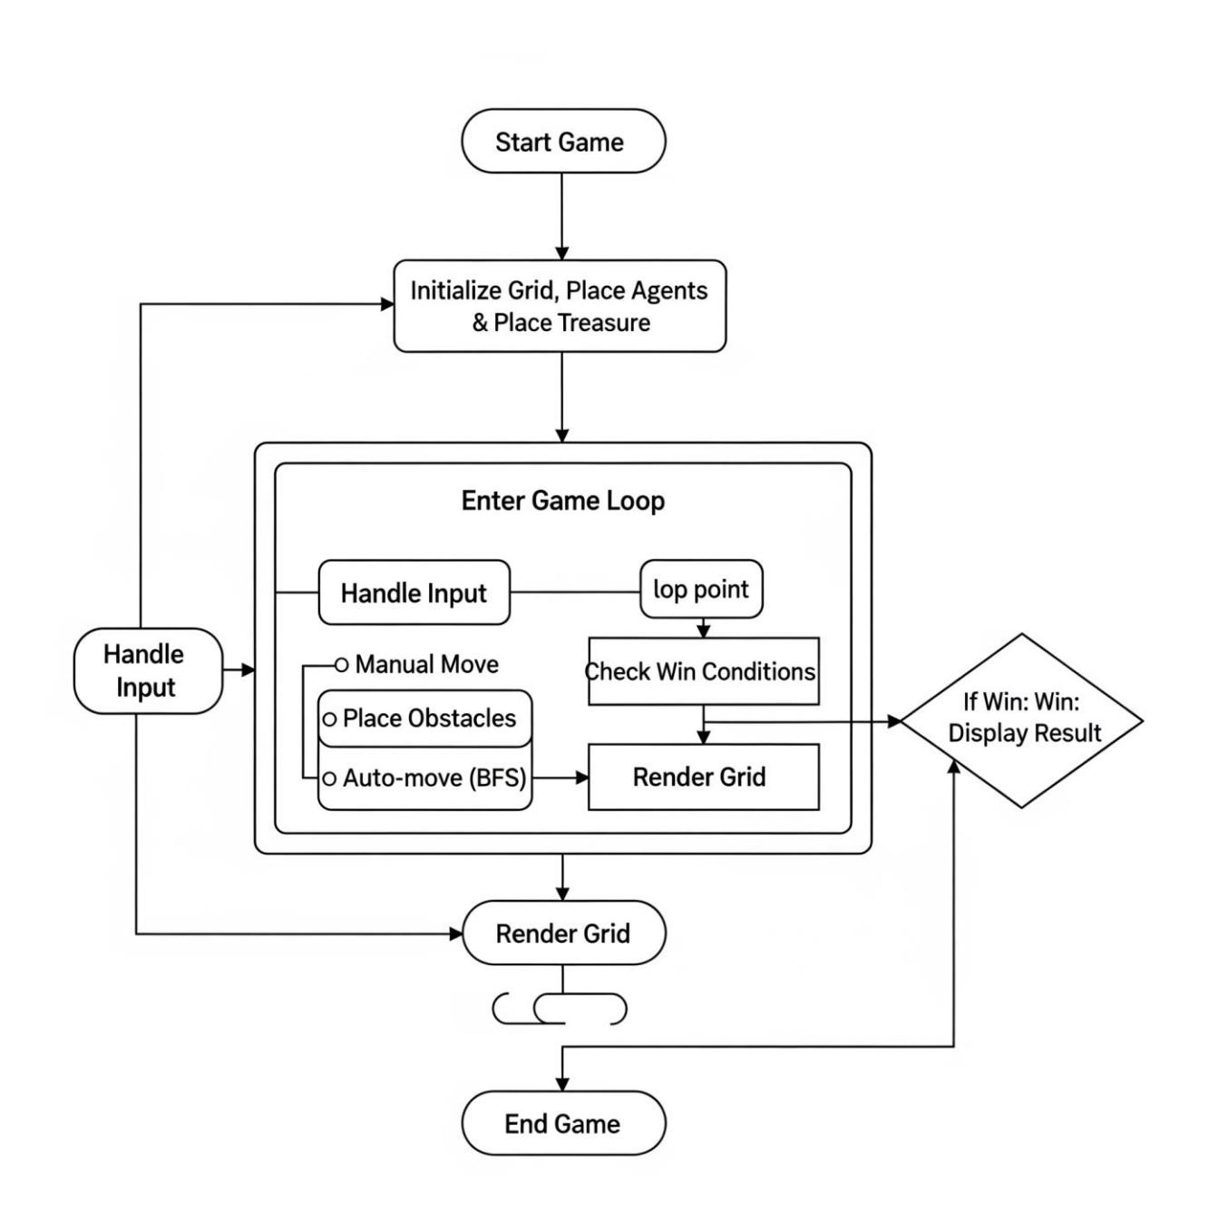
Game Flow
Visual representation of game
logic and interactions.

Slide 8
Evaluation Metrics
1
Win Condition Accuracy
Correctly detects treasure reach.
2
Pathfinding Efficiency
BFS guarantees shortest paths.
3
Game Responsiveness
Timely input and visual updates.
4
Strategic Complexity
Effective obstacle placement.
5
User Engagement
Clear visuals, intuitive controls.

Slide 9
Algorithm Complexities
BFS Pathfinding
Movement & Obstacle Placement
Time: O(V + E)
Constant time checks.
Space: O(V)
Valid moves, obstacle placement.
Efficient for 10x10 grid.

Slide 10
Test Cases
1
2
TC1: Treasure Distance
TC2: Agent Movement
Not too close to agents.
Agent moves successfully.
3
4
TC3: Blocked Movement
TC4: Obstacle Placement
Movement blocked by obstacle/agent.
Obstacle placed adjacent to agent.
5
6
TC5: Auto-Move Clear Path
TC6: Auto-Move No Path
Agent moves one step towards treasure.
Agent stays in place.
7
8
TC7: Simultaneous Win
TC8: Out of Bounds
Game ends, both reached.
Movement prevented.

